Slide 1



From Monolith to Modulith
Unlocking the Power of Hexagonal Architecture in Java
Auke Haanstra
#jfall
Notes:
Subject slides

Slide 2


Auke Haanstra ∙ From Monolith to Modulith: Unlocking the Power of Hexagonal Architecture in Java
Introduce myself
Auke Haanstra, consultant expert level at Pancompany
Expertise: Test-Driven Development and Hexagonal Architecture
8 years of experience in Java development
35 colleagues Java developers in our Java Competence
Notes:
First slide

Slide 3
Auke Haanstra ∙ From Monolith to Modulith: Unlocking the Power of Hexagonal Architecture in Java
Contents
The Monolith: setting the stage
The Modulith: Hexagonal architecture and Java modules
Example: Unicorn App
HA and Testing
HA as an enabler technology
Migrating with Spring Modulith: Unicorn Demo App
Notes:
First slide

Slide 4

Auke Haanstra ∙ From Monolith to Modulith: Unlocking the Power of Hexagonal Architecture in Java
└ 1. The Monolith: setting the stage (1/3)
The Monolith
Notes:
First slide

Slide 5
Auke Haanstra ∙ From Monolith to Modulith: Unlocking the Power of Hexagonal Architecture in Java
└ 1. The Monolith: setting the stage (2/3)
The Monolith
The Metaphor of the Big Ball of Mud
Lack of Structure/Architecture
Lack of Modularity
Messy code
Hard to test
Resistence to change – Tight coupling.
Notes:
First slide

Slide 6

Auke Haanstra ∙ From Monolith to Modulith: Unlocking the Power of Hexagonal Architecture in Java
└ 1. The Monolith: setting the stage (3/3)
Are microservices the solution?
Sometimes, but often they bring too much complexity
Often, the microservices-first approach is a bad idea
Microservices bring much
Complexity
Operational overhead
Performance issues
You need to have the context boundaries right at first
“Distributed balls of mud”
Notes:
First slide

Slide 7
Auke Haanstra ∙ From Monolith to Modulith: Unlocking the Power of Hexagonal Architecture in Java
└ 1. The Monolith: setting the stage (3/5)
The Distributed Monolith
Notes:
First slide

Slide 8
Auke Haanstra ∙ From Monolith to Modulith: Unlocking the Power of Hexagonal Architecture in Java
└ 1. The Monolith: setting the stage (4/5)
The Distributed Monolith
Also Microservices can degrade to
Distributed Balls of Mud!
Tight coupling
Not independently deployable
Single Database
REST/gRPC APIs
Synchronous communication
Cascading failures
Notes:
First slide

Slide 9
Auke Haanstra ∙ From Monolith to Modulith: Unlocking the Power of Hexagonal Architecture in Java
└ 1. The Monolith: setting the stage (5/5)
The context: Agile
Nowadays, we should want, and business expects us to:
Rapidly respond to change
Continuously deliver value increments
Collaborate in interdisciplinary teams
Reduce risk through iteration (feedback loops)
Focus on the end-user
Notes:
First slide

Slide 10

Auke Haanstra ∙ From Monolith to Modulith: Unlocking the Power of Hexagonal Architecture in Java
└ 6. Example with Spring Modulith: Unicorn Demo App (1/5)
Agility the right way
To do a microservices architecture well, you need to have multiple teams
One Microservice per Interdisciplinary Agile Team is ideal
Whether we build a monolith or microservice: a good architecture facilitates CI/CD and Agility
Notes:
DevOps is about removing silos between seperate teams, it is a culture. So there is no such thing as a DevOps team, or a DevOps developer position.

Slide 11
Auke Haanstra ∙ From Monolith to Modulith: Unlocking the Power of Hexagonal Architecture in Java
One team per microservice
Autonomy, clear ownership, independent deployment
Reduced cognitive load and focused expertise
Scalability (more microservices = more teams)
Better handling of network complexity
(Platform and day-to-day management of network concerns by specialized teams)
Notes:
First slide

Slide 12
Auke Haanstra ∙ From Monolith to Modulith: Unlocking the Power of Hexagonal Architecture in Java
└ 2. The Modulith: Hexagonal architecture and Java modules (1/4)
Hexagonal architecture to the rescue
Hexagonal architecture provides a simple and well-defined architecture that emphasizes the use of ports (APIs for adapters and the application)
These port interfaces can be used to run tests against, and decouple the application and domain from technical details
It provides technical flexibility, excellent testability and maintainability
In combination with Java Modules, we have a Modulith
Notes:
First slide

Slide 13
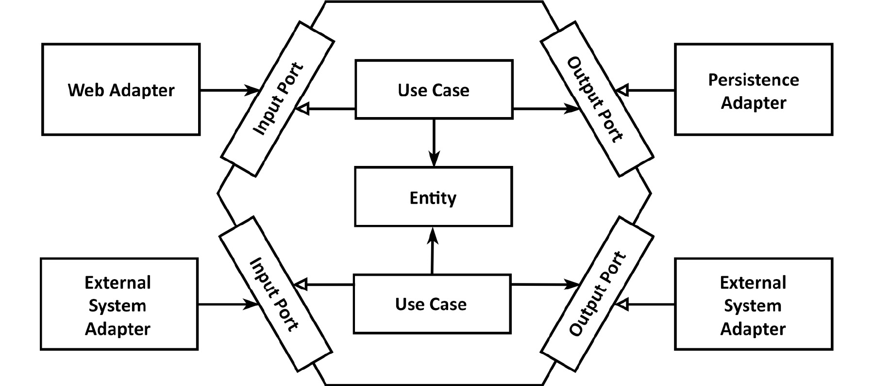
Auke Haanstra ∙ From Monolith to Modulith: Unlocking the Power of Hexagonal Architecture in Java
└ 2. The Modulith: Hexagonal architecture and Java modules (2/4)
The Modulith: Hexagonal architecture
Notes:
First slide

Slide 14
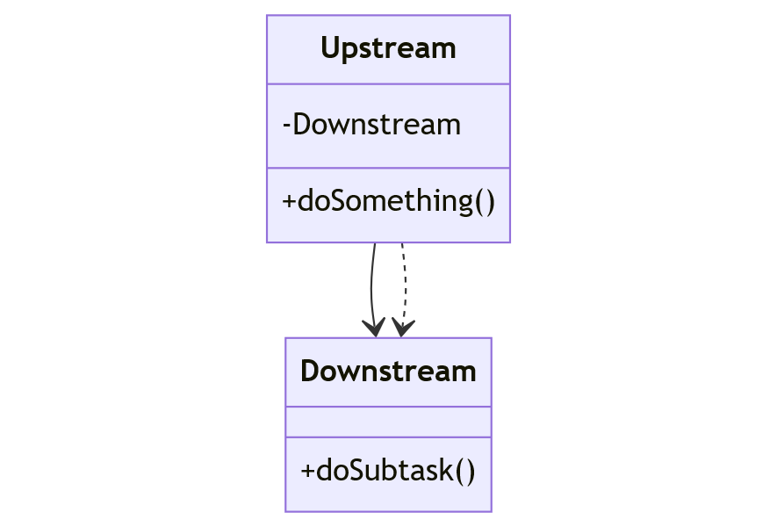
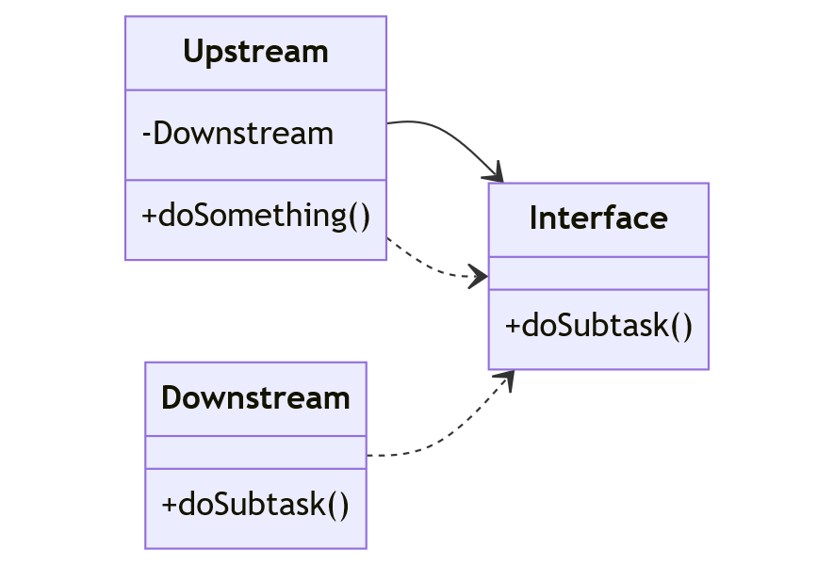
Auke Haanstra ∙ From Monolith to Modulith: Unlocking the Power of Hexagonal Architecture in Java
└ 2. The Modulith: Hexagonal architecture and Java modules (3/4)
Dependency Inversion
Regular
Dependency Inversion
Upstream
Notes:
First slide

Slide 15
Auke Haanstra ∙ From Monolith to Modulith: Unlocking the Power of Hexagonal Architecture in Java
└ 2. The Modulith: Hexagonal architecture and Java modules (4/5)
Hands-on!
Let’s create a simple Hexagonal Architecture application using TDD!
Notes:
First slide

Slide 16

Auke Haanstra ∙ From Monolith to Modulith: Unlocking the Power of Hexagonal Architecture in Java
└ 2. The Modulith: Hexagonal architecture and Java modules (5/5)
The Modulith: Java modules
Adapters can be compiled as automatic modules
Then they can be used by a runtime-modular application, but are dependent on both the module path and classpath
The application’s modules can be compiled as Java modules, but run from a “non-modular main” on the classpath
Spring does not support Java modules, that’s why this technique is especially suited for Spring applications
Notes:
Nog in het Engels!

Slide 17
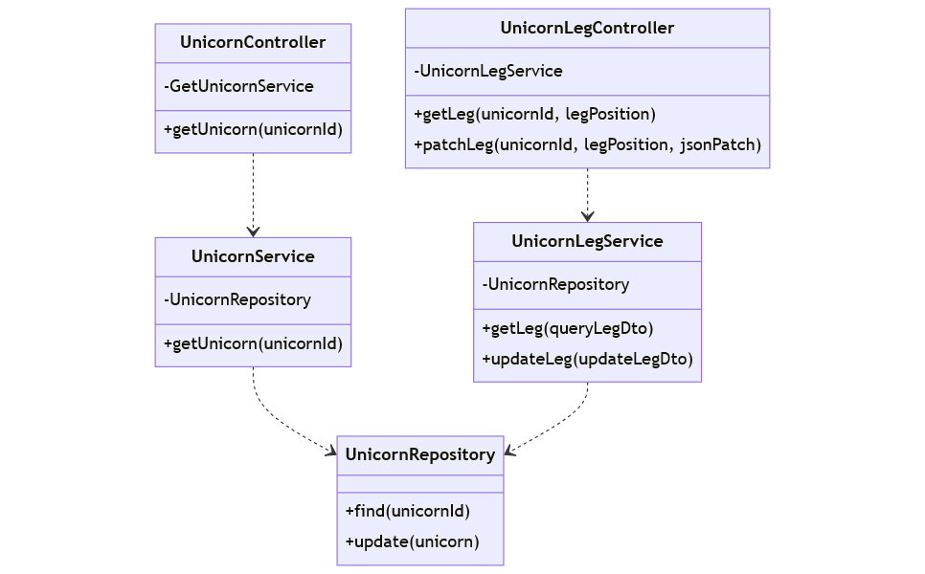

Auke Haanstra ∙ From Monolith to Modulith: Unlocking the Power of Hexagonal Architecture in Java
└ 3. Example: Unicorn App (1/4)
Example: Unicorn App
Notes:
First slide

Slide 18
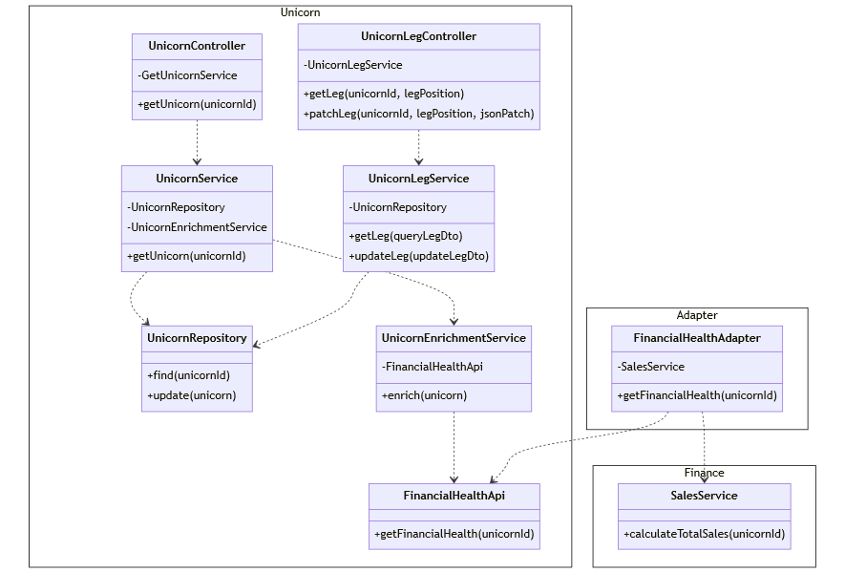
Auke Haanstra ∙ From Monolith to Modulith: Unlocking the Power of Hexagonal Architecture in Java
└ 3. Example: Unicorn App (2/4)
Notes:
First slide

Slide 19
Auke Haanstra ∙ From Monolith to Modulith: Unlocking the Power of Hexagonal Architecture in Java
└ 3. Example: Unicorn App (3/4)
(Comparative) Example: code
Comparing versions of the Unicorn App
3-tier web app (web+application+data)
Hexagonal Architecture (HA)
HA + Java modules
Notes:
First slide

Slide 20
Auke Haanstra ∙ From Monolith to Modulith: Unlocking the Power of Hexagonal Architecture in Java
└ 3. Example: Unicorn App (4/4)
Advantages of Moduliths
Advantages of HA
Simple architecture
Flexibility adapters (and properties)
Focus on the domain
Testability – more on that later…
Advantages of modules
Guarding the architectural boundaries
Notes:
First slide

Slide 21
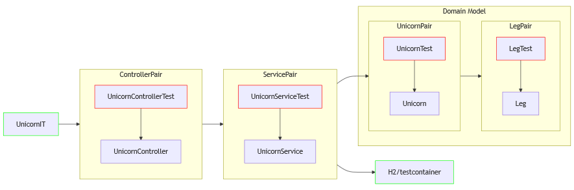
Auke Haanstra ∙ From Monolith to Modulith: Unlocking the Power of Hexagonal Architecture in Java
└ 4. HA and Testing (1/4)
Testing: test-per-class
More later!
Notes:
First slide

Slide 22
Auke Haanstra ∙ From Monolith to Modulith: Unlocking the Power of Hexagonal Architecture in Java
└ 4. HA and Testing (2/4)
Problem
Test-per class methodology introduces coupling between tests and production code
This makes it hard to refactor, your code resists change, making it rigid
Refactoring shoots holes in your safety net
More later!
Notes:
First slide

Slide 23
Auke Haanstra ∙ From Monolith to Modulith: Unlocking the Power of Hexagonal Architecture in Java
Two types of TDD
Two methodologies
Mockist TDD (“Outside-in”, “top-down”, “London school”)
Start at the outside of the application
Pre-knowledge required for a good design
Classicist TDD (“Inside-out”, “bottom-up”, “Chicago school”)
Start at the inside of the application: its usecases and domain
Design evolves through refactoring
More later!
Discussed
a moment ago
Code example
unicorn-app
Notes:
First slide

Slide 24
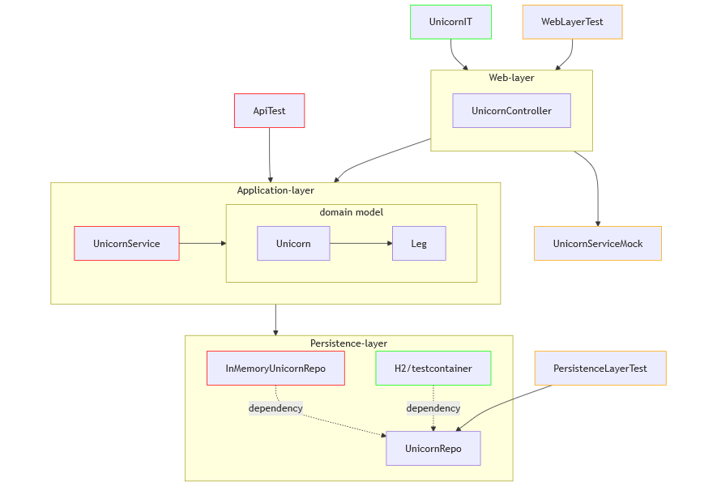
Auke Haanstra ∙ From Monolith to Modulith: Unlocking the Power of Hexagonal Architecture in Java
└ 4. HA and Testing (3/4)
Testing the API
APIs should be the most stable parts of your application!
More later!
Black box
Notes:
First slide

Slide 25
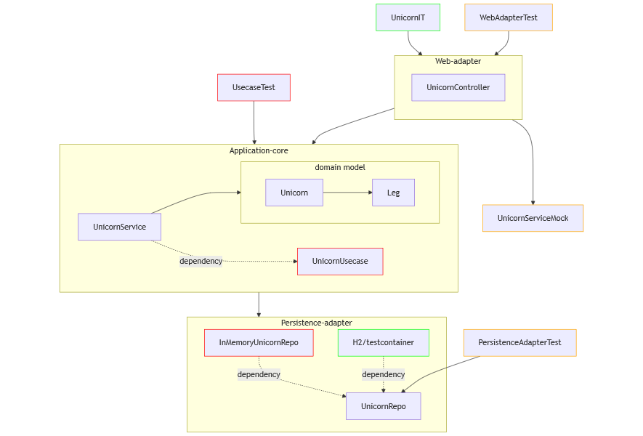
Auke Haanstra ∙ From Monolith to Modulith: Unlocking the Power of Hexagonal Architecture in Java
└ 4. HA and Testing (4/4)
Testing: Hexagonal Architecture
More later!
Notes:
First slide

Slide 26
Auke Haanstra ∙ From Monolith to Modulith: Unlocking the Power of Hexagonal Architecture in Java
└ 5. HA as an enabler (1/2)
Hexagonal architecture is an enabler
A very simple “ports-and-adapters” pattern
By separating domain from infrastructure, we can:
Practice TDD and Refactoring
Practice Object-Oriented Design on our domain entities
Practice Domain Driven Development (DDD)
Modularize our application along architectural boundaries
Hexagonal architecture is therefore an enabler for good software development practices!
Notes:
First slide

Slide 27
Auke Haanstra ∙ From Monolith to Modulith: Unlocking the Power of Hexagonal Architecture in Java
└ 5. HA as an enabler (2/2)
According to Amazon Web Services…
“Hexagonal architecture encourages the engineering team to solve the business problem first, whereas classical layered architecture shifts engineering focus away from the domain to solving technical problems first.”*
“DDD [Domain-driven design] helps manage business complexity and scale the engineering team as new features are developed.” *
“DDD is easier to implement when teams use hexagonal architecture. [...] This [hexagonal architecture] aligns perfectly with DDD, where a domain is the core of the application that solves a business problem.” *
“Furthermore, if software follows a hexagonal architecture, it’s easier to adopt a test-driven development approach, which reduces the feedback loop that developers need to test business requirements.” *
“We recommend that you adopt hexagonal architecture for all your enterprise software projects regardless of their complexity.”
*AWS Prescriptive Guidance: Building hexagonal architectures on AWS, 2022
Notes:
First slide

Slide 28

Auke Haanstra ∙ From Monolith to Modulith: Unlocking the Power of Hexagonal Architecture in Java
└ 6. Example with Spring Modulith: Unicorn Demo App (1/5)
Spring modulith: a different approach
Hexagonal architecture does not tell us much about how to deal with multiple bounded contexts
Spring modulith does!
Notes:
DevOps is about removing silos between seperate teams, it is a culture. So there is no such thing as a DevOps team, or a DevOps developer position.

Slide 29
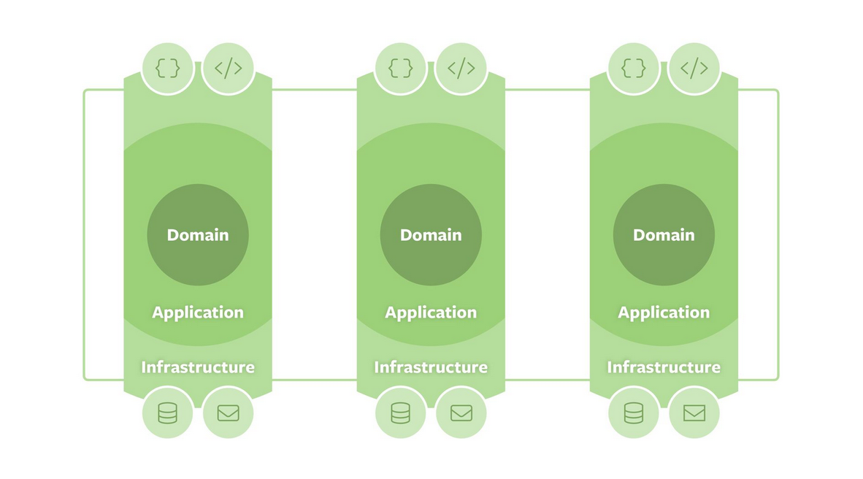
Auke Haanstra ∙ From Monolith to Modulith: Unlocking the Power of Hexagonal Architecture in Java
└ 6. Example with Spring Modulith: Unicorn Demo App (2/5)
Spring Modulith to the rescue
Vertical slicing of DDD Bounded Contexts
Enforcing boundaries with predefined ArchUnit rules under-the-hood
Highly configurable, so perfect for gradual migration (OPEN and CLOSED ApplicationModules, @NamedInterface)
Facilitates an event-driven architecture
Facilitates migration of this event-driven architecture to microservices (via @Externalized)
Allows for any technical architecture (layered, HA, Onion, CQRS, Java modules)
Notes:
First slide

Slide 30
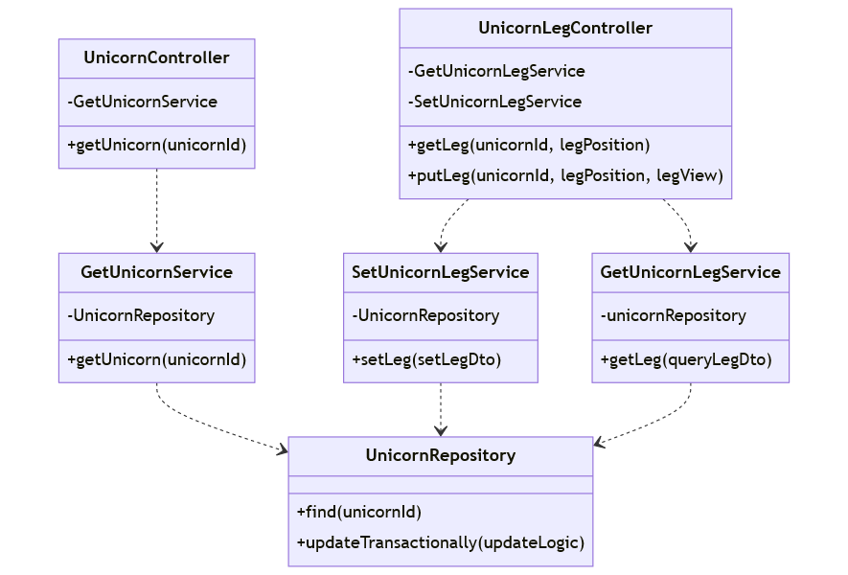

Auke Haanstra ∙ From Monolith to Modulith: Unlocking the Power of Hexagonal Architecture in Java
└ 6. Example with Spring Modulith: Unicorn Demo App (3/5)
Example: Unicorn Demo App
Notes:
First slide

Slide 31
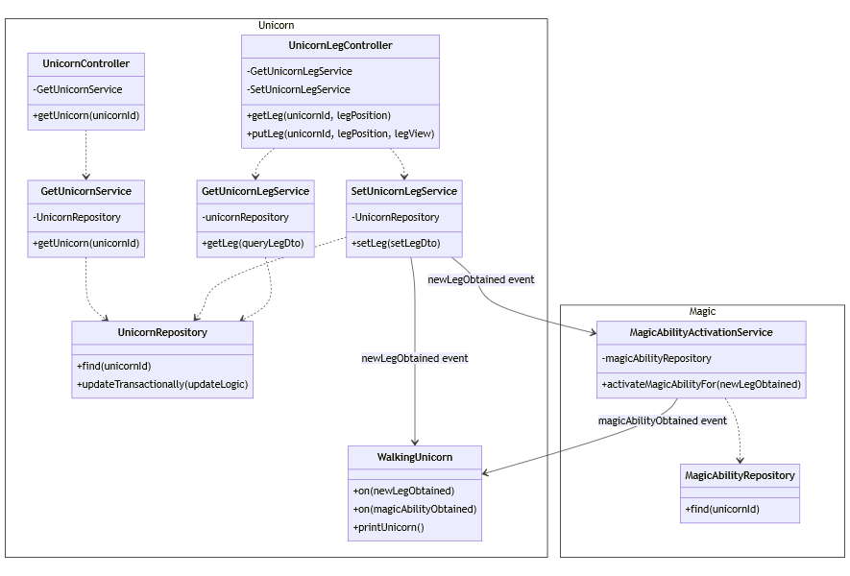
Auke Haanstra ∙ From Monolith to Modulith: Unlocking the Power of Hexagonal Architecture in Java
└ 6. Example with Spring Modulith: Unicorn Demo App (4/5)
Event
messaging
Hands-on!
Modularization example
(if time allows)
Notes:
First slide

Slide 32

Auke Haanstra ∙ From Monolith to Modulith: Unlocking the Power of Hexagonal Architecture in Java
└ 7. Example with Spring Modulith: Unicorn Demo App (5/5)
Migrating to the Modulith
A best practices approach
The Modulith: a modular monolith
Migrating from a Monolith:
Building a safety net with acceptance (e.g. integration) tests
Gradual untangling of vertical slices/bounded contexts with Spring Modulith
Untangle (Separation of concerns), decouple (DI) and put proper APIs in place
Implement a clean architecture (e.g. HA)
Modularize along the architectural boundaries
Create and run unit tests against those APIs
Now you are free to
Refactor
Implement DDD and a rich domain model (OO)
Notes:
First slide

Slide 33
Auke Haanstra ∙ From Monolith to Modulith: Unlocking the Power of Hexagonal Architecture in Java
Examples on Github
unicorn, unicorn-hexagonal and unicorn-modules apps
show how to refactor from a three-tier architecture to a modularized hexagonal architecture, a modulith
unicorn-demo-vertically-sliced and unicorn-demo-modular apps
show how to refactor from a vertically-sliced modulith to a vertically-sliced, truly modular, hexagonal architecture.
Notes:
First slide

Slide 34
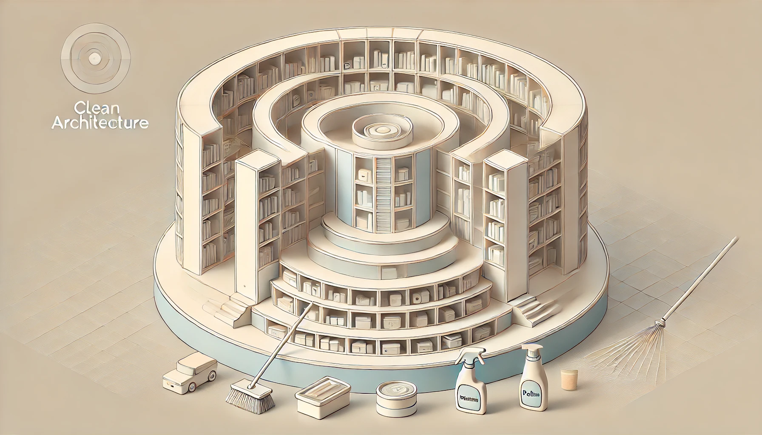
Auke Haanstra ∙ From Monolith to Modulith: Unlocking the Power of Hexagonal Architecture in Java
Example on Github
Production-grade microservice example: clean-architecture-app
Clean architecture from Robert C. Martin
Modules and ArchUnit protect architectural boundaries
Elaborate properties and component configuration for flexibility and separation of concerns
Code coverage with Jacoco
Usecase and adapter integration tests
Testbuilders
Unit tests
Rich (OO) domain model
Notes:
First slide

Slide 35

Auke Haanstra ∙ From Monolith to Modulith: Unlocking the Power of Hexagonal Architecture in Java
What to choose?
Notes:
First slide

Slide 36

Auke Haanstra ∙ From Monolith to Modulith: Unlocking the Power of Hexagonal Architecture in Java
TDD and Hexagonal Architecture
Would you like to know more about TDD with Hexagonal Architecture?
Next year we will organize a meetup!
Let your badge be scanned when leaving the room, and we will keep you up to date!
Notes:
First slide

Slide 37

Thanks for your attention
Please rate my session in the J-FALL app
https://github.com/AukeHaanstra
#jfall
Notes:
Subject slides

Slide 38



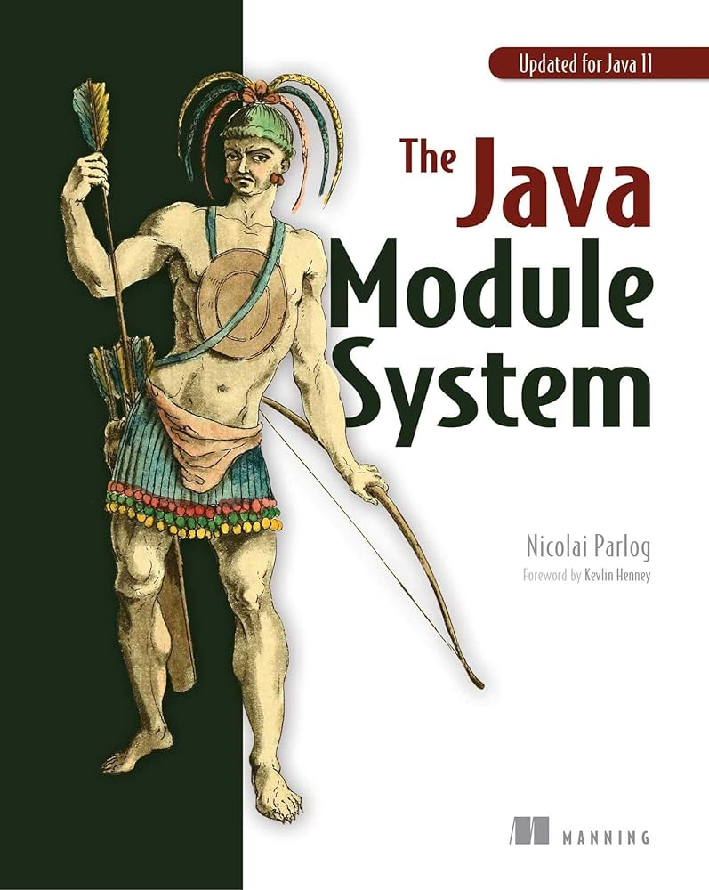

Auke Haanstra ∙ From Monolith to Modulith: Unlocking the Power of Hexagonal Architecture in Java
Further reading
Get Your Hands Dirty on Clean Architecture, Tom Hombergs
https://docs.aws.amazon.com/prescriptive-guidance/latest/hexagonal-architectures/welcome.html (also in PDF formaat)
Migrating your Spring Boot application to Java Modules by Jaap Coomans – YouTube (presentation @ Devoxx)
https://cleancoders.com/library/all (Clean Code series videos by Robert C. Martin, aka Uncle Bob)
Agile Software Development: Principles, Patterns and Practices, Robert C. Martin (aka Uncle Bob)
The Java Module System, Nicolai Parlog
https://github.com/TomCools/jpms-hexagonal-architecture (example project by Tom Cools)
Notes:
First slide

